Slide 1
Yao’s Garbled Circuits
Theory and practice
(Mostly) no knowledge Required

Slide 2
What Cryptography is Used For
Secret messages
Ceasar cipher
Vigenère cipher
Enigma
Modern Encryption
Multiparty computation
Decision making
Voting
Secret Sharing
Notes:
Activity with deck of 5 cards. Ask someone on a date. Challenge to come up with 4 card solution or less.

Slide 3
Symmetric Key Encryption
Alice and Bob agree on a secret key
Alice uses the key to encrypt a secret message
The encrypted message gets sent to Bob
Bob uses the same secret key to decrypt the ciphertext
Now Bob knows the content of the message
Eve intercepts the message
She can try to read it, but without the secret key, she will not be able to decrypt the message
Notes:
Define highlighted terms

Slide 4

Key Transfer
Alice and Bob want to have the same secret key
If they agree on a key out loud, their encryption will not be secure
Key Transfer allows Alice and Bob to generate the same key as each other without anyone else knowing what it is
Not necessarily the key that they chose
Once they send a secure encrypted message, they can decide what the next key will be inside the message
Key Transfer only needs to be run one time
Notes:
Key Transfer activity:
2 students
Announce public color
Choose secret color
Mix and each announce hex of color (assume unmixing colors from hex is difficult)
Mix and get final color

Slide 5
Oblivious Transfer
Necessary for many Multiparty Computation algorithms
Evan needs to make a choice between two options
Evan doesn’t want Ginny to know his choice
Ginny knows both options, but she doesn’t want Evan to learn anything about the option that he doesn’t choose.
Choice b (b∈{0,1})
Ginny
Message 0
Oblivious Transfer
Evan
Message 1
Message b

Slide 6
One-way function
Function that is easy to compute, but hard to reverse
Given the output of such a function, someone cannot find the associated input in polynomial time
Example: Hash Function
Takes an input of any size
Returns an output of a specified size
Deterministic, not Random
Hash(‘abc’) = ‘A9993E364706816ABA3E25717850C26C9CD0D89D’
Hash(‘abb’) = ‘C64D3FCDE20C5CD03142171E5AC47A87AA3C8ACE’
Hash(the bible) = ‘D62A49BFA992E91B00C540B2EDED613976649DD7’

Slide 7
Circuits
Series of gates that takes a set number of inputs
Boolean Circuit
The inputs are bits, either 1 or 0 to correspond with True or False
Each gate is either a logical AND or a logical OR
Arithmetic Circuit
The same thing but inputs are numbers
Gates are multiply (*) and add (+)
Boolean Circuits can be written as Arithmetic Circuits and vice versa
Any polynomial can be written as a circuit!

Slide 8
Yao’s Garbled Circuits
A way to encrypt circuits so that no more information is exposed than what would already be learned just from seeing the output
Can be accomplished using each of the topics we discussed
Symmetric Key Encryption
Key Transfer
Oblivious Transfer
One-way Functions
Ginny “garbles” a circuit using her inputs, then sends the circuit to Evan
Evan evaluates the circuit using his inputs, and receives the output

Slide 9
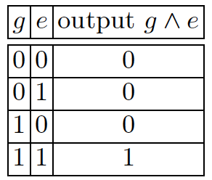
HOW? Garbling
Ginny picks four random labels for inputs: W_{0G}, W_{1G}, W_{0E}, W_{1E}
For each possible outcome of the gate, Ginny now has (W_{G}, W_{E}, Output)
Ginny uses Symmetric Key Encryption to encrypt each output using the hash of two labels combined as the secret key
Hash(W_{G}+W_{E}) = secret key
Garbled Output = Enc(secret key, output)
Finally, Ginny changes the order of the Garbled Outputs

Slide 10
HOW? Evaluating
In order to evaluate, Ginny gives Evan W_{Gg}, the random label that goes with her choice bit g
Because the labels are random, this doesn’t give Evan any information about Ginny’s choice
Evan also needs W_{Ee}, the random label that goes with his choice bit e
To get this to Evan, they must use Oblivious Transfer
Now that Evan has both W_{Gg} and W_{Ee}, he can compute the secret key
Secret key = Hash(W_{Gg} + W_{Ee})
Finally, with one of the four secret keys, he can try to decrypt the garbled outputs

Slide 11
Fun Stuff: Symmetric Key Encryption
Perfectly Secure for symmetric encryption
Same as Vigenère, but the key is the same length as the message
Not usually used because Key Transfer is rather expensive for large keys, and each key can only be used once.
Since our messages are in binary, can use XOR (⊕) to encrypt
Today people use something called AES for encryption
There’s also something called Asymmetric Key Encryption
Can give another talk about different cryptosystems if there’s interest

Slide 12
Fun Stuff: Diffie-Hellman Key Transfer

Slide 13
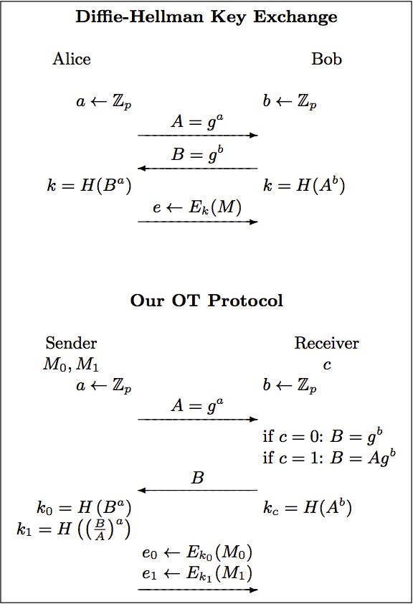
Fun Stuff: Oblivious Transfer

Slide 14
Fun Stuff: Hash Algorithm
Simplest hash algorithm:
Take an input string of any size
If it’s shorter than needed, pad until it’s the right size
If it’s longer, cut off the beginning
Then XOR it with a secret string of the right length
SHA is a family of hash algorithms that are widely used and are considered secure.

Slide 15
Fun Stuff: Garbled Circuits
To garble a gate that uses other gates outputs as their inputs,
Ginny will encrypt two labels W_{w0} and W_{w1} that go with the output bit

Slide 16
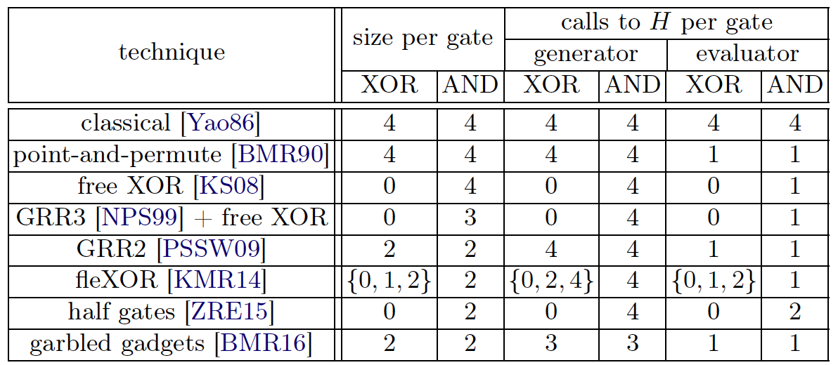
Fun Stuff: Garbled Circuits
Put it all together

